Slide 1


Workflow
The Galactics
Change Management Project
Jordy Ruiz
Katherine Arauz
Mabel Alvarez
Brian Betancurth
Gilberto Matos

Slide 2
Change Management Project - Workflow
Under the direction of Accenture, we are currently working with different forms that allows to plan, analyze and manage the implementation of the Workflow process in the different departments of the Bank
Forms :
- Ficha Recogida Informacion: Breakdown of the workflow process to be implemented and their respectively areas of impact

Slide 3
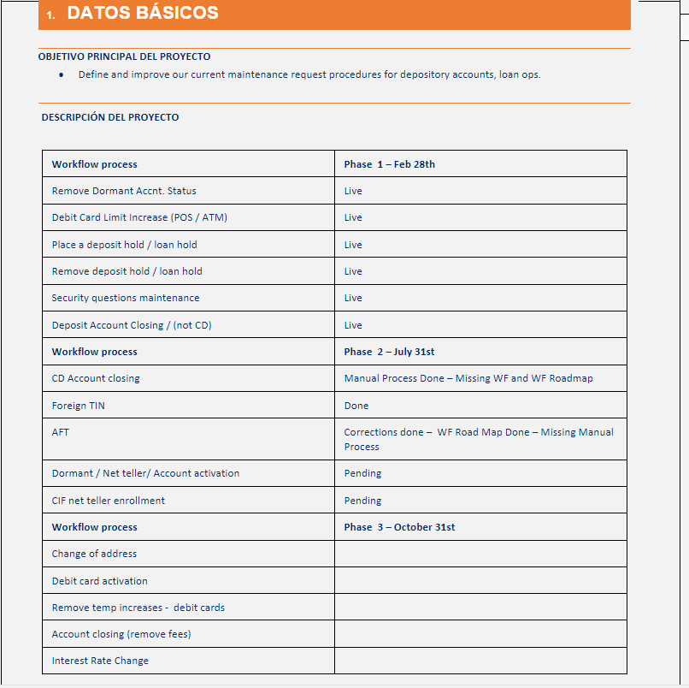
Change Management Project Workflow
With this form, we broke down the workflow implementation in three different phases:
Phase 1 – (Live) – Feb 28 2023
Phase 2 – (in process) – July 31 2023
Phase 3 – (Planning) – October 31 2023

Slide 4
Workflows per phase
Phase 1
Remove Dormant Acct Status
Debit Card Limit Increase
Place a deposit hold
Remove a deposit hold
Security Questions Maintenance
Close a Deposit account (Not CD’s)
Phase 2
Close CD accounts
Foreign Tin Maintenance
Automatic Fund Transfer
Activate Dormant NetTeller
CIF NetTeller Enrollment
Phase 3
Change of Address
Debit Card Activation
Remove Temporal Debit Card Increases
Account Closing (Fee Removal)
Interest Bearing Change

Slide 5
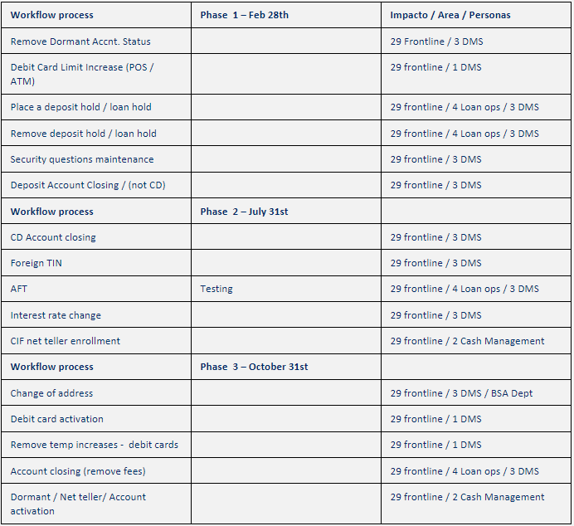
Impact Per Department
Each Phase will have: 4 mini-phases :
1.- Defining and Evaluation Process to create the Workflow Roadmap / Manual time vs workflow time
2.- Implementation and Testing
3.- Presenting Worklow process (Findings and Feedback)
4.- Finalizing and Training Areas Impacted

Slide 6
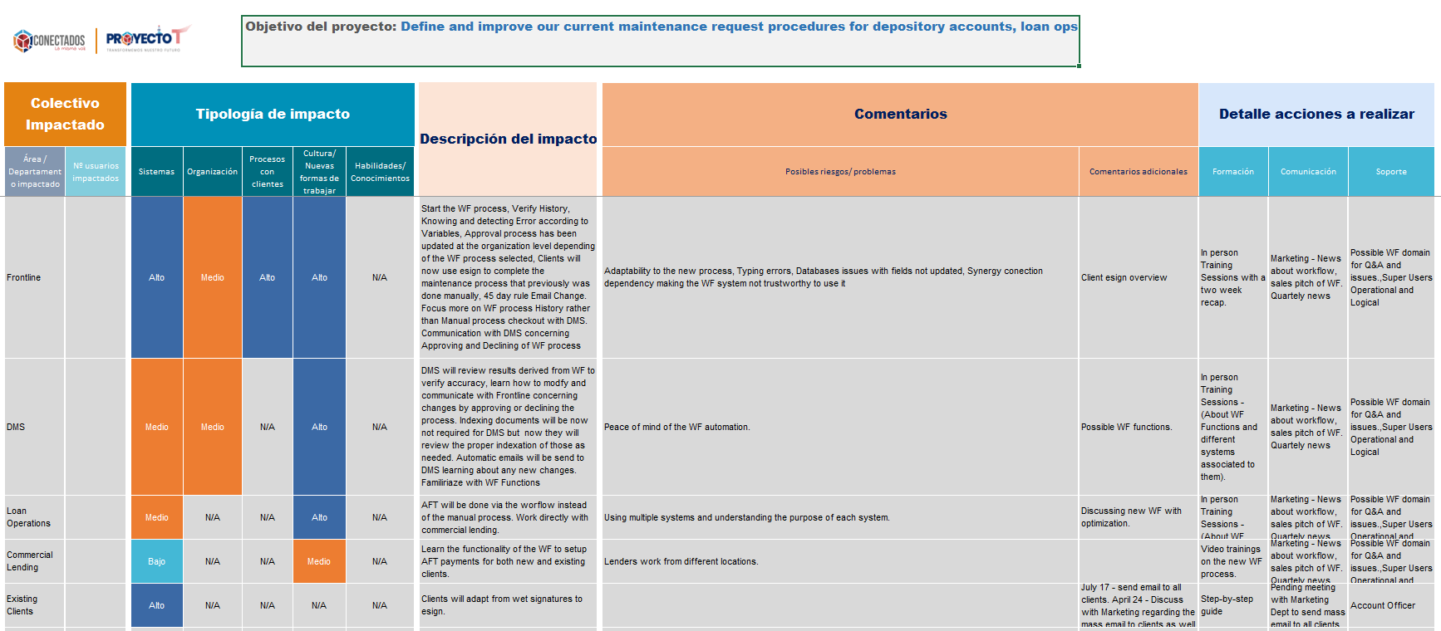
Impact Analysis Form

Slide 7

FICHA DE COMUNICACIÓN
Send Email to Participants
Examples
SuperView User Examples Meeting
SuperView User Assignments
Notify participants about the WF training on July
Send group pf examples to participants to check they understanding of the different functions of the workflow system
Overview of all examples given to participants in order to know how to address questions and doubts
- Katherine Arauz – DMS & 7th Floor
Gilberto Matos – Loan Ops
Brian Betancurth – Commercial Lending
Mabel Alvarez – New York
WF Email
WF Email
Jordy Ruiz
All Participants – All Depts
All Participants – All Depts
SuperView Users
Email
Email
In Person Meeting
Two weeks Prior Training Day
Next day after training
Wednesday June 28th 2023
N/A
Examples
Examples Doc

Slide 8

Session 1
Session 2
Video Training 1
Introduction, Explanation and walkthrough all workflow functions
Introduction, Explanation and walkthrough all workflow functions
Introduction to WF and how to access it
In person
In person
Video
Jordy Ruiz, Brian Betancurth
Jordy Ruiz, Brian Betancurth
??????
DMS.
Loan Operations
Commercial Lending
What is WF?, Tools and resources, Start a WF, Review History, Detect Errors. Run Testing, Q & A
What is WF?, Tools and resources, Start a WF, Review History, Detect Errors. Run Testing, Q & A
How to access it,
Navigate functions (Queue)
Thursday July 6th 2023 – Training
Follow up Meeting – Friday July 21 2023
Friday July 7th 2023 – Training
Follow up Meeting – Friday July 21 2023
Wednesday May 31st 2023
PPT Presentation
Examples
PPT Presentation
Examples

